Slide 1

Padmashali shikshan sanstha’s
A. R. Burla Mahila Varishtha Mahavidyalaya, Solapur.
Project Title:
“Burqa Shop Website”
Developed By:
Javeriya Mujawar (2301)
Tuba Bagwan (2315)
Course: BCA III
(2024-25)

Slide 2
Introduction
The Burqa Shop Website is an e-commerce website for Naqab Collection Shop that facilitates the sale of Islamic women’s clothing, including Burqa, Abaya, Naqab, Hijab, and accessories.
This platform aims to provide a seamless and convenient shopping experience for users.
Users can browse products, add items to their cart, and place orders easily.
Improve accessibility by offering a responsive design for mobile and desktop users.
The system also includes an admin panel for managing products, orders, and user queries efficiently.

Slide 3
Technologies Used
Frontend : HTML, CSS, JAVASCRIPT
Backend: PHP
Database: MYSQL
Server: Apache XAMPP

Slide 4
Features of the Website
User Features:
User Registration & Login
Product Browsing & Search
Cart & Checkout System
Order Management
Query Submission
Admin Features:
Product Management
Order Management
User Management
Sales Report Management

Slide 5
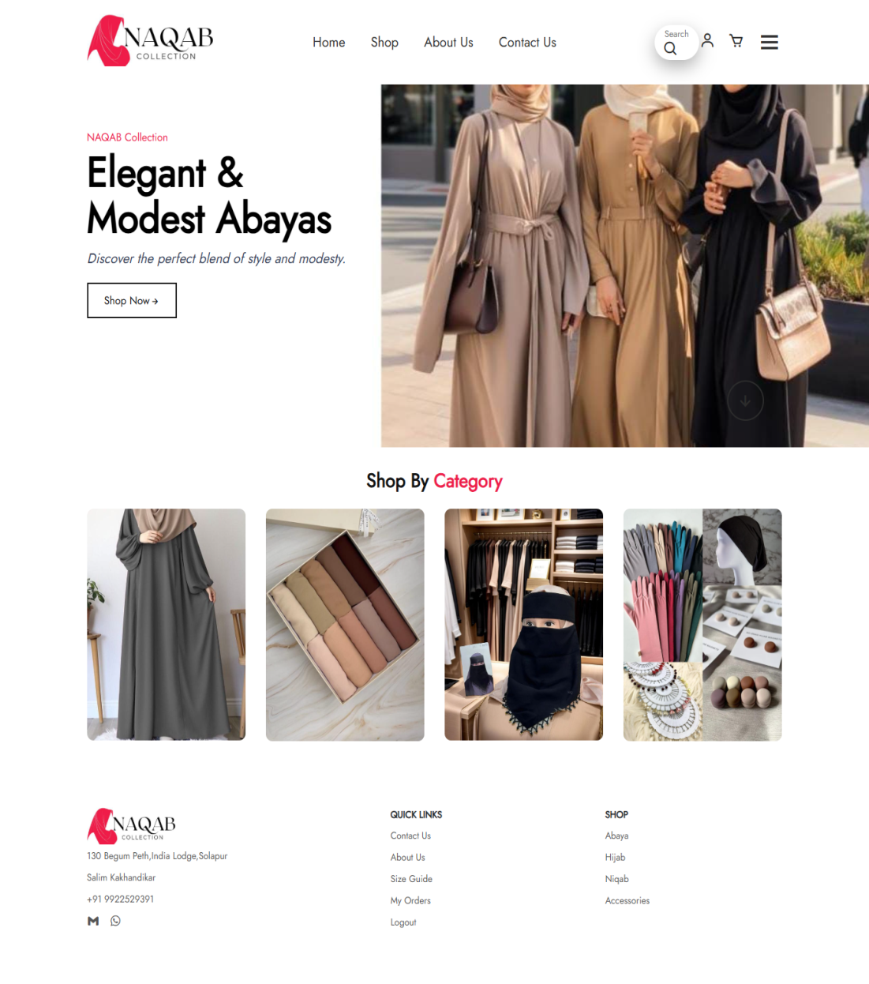
Website Demo:
Home Page
Displays an attractive banner with featured products.
Includes a navigation menu for easy access to all pages.
A search bar for finding specific products quickly.

Slide 6
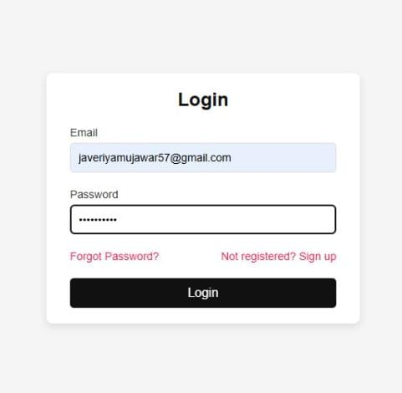
Login Page
Allows users to log in with email and password.
New users can register by providing name, email, password, and phone number.
Option for password reset in case of forgotten credentials.

Slide 7
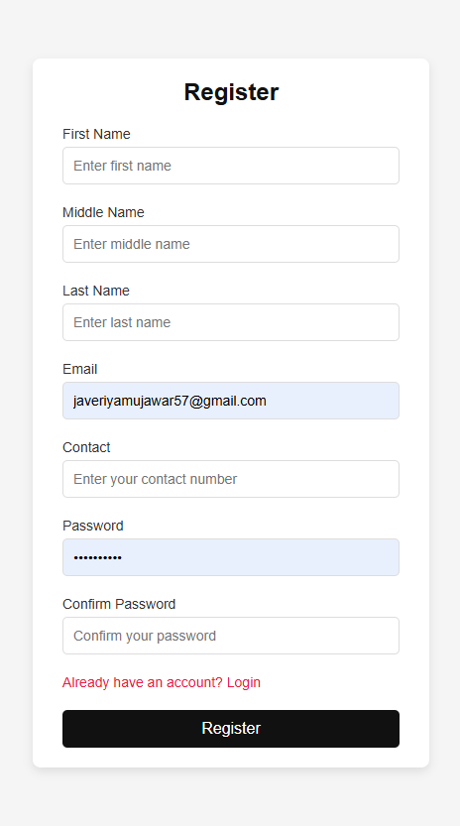
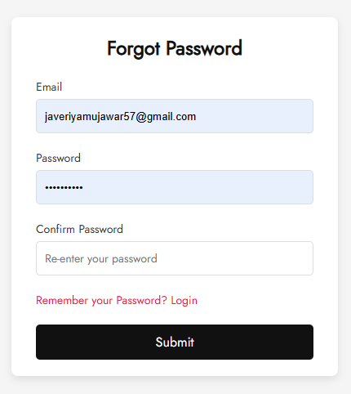
Registration & Forgot Password Page

Slide 8
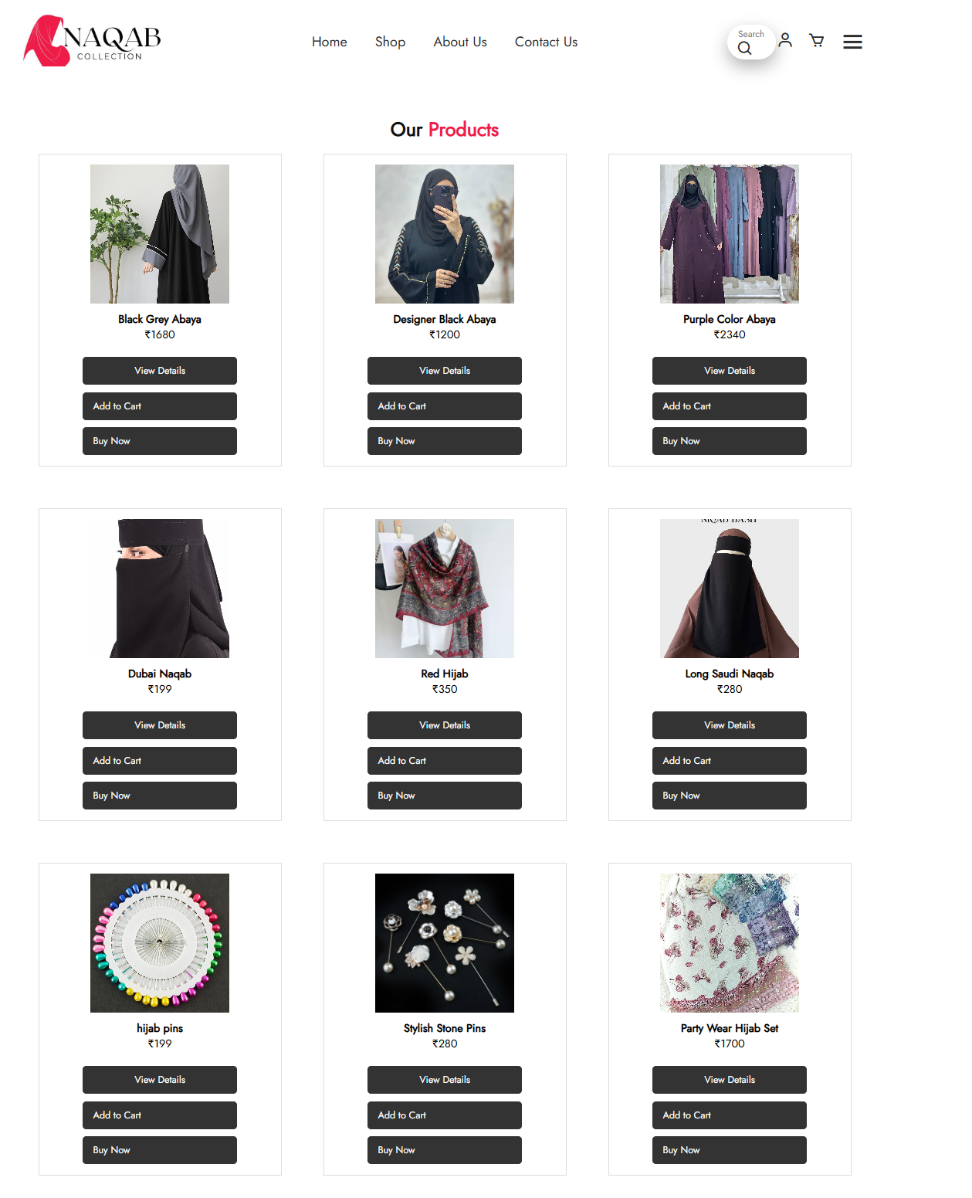
Shop Page
Displays all available products with images, names, and prices.
Includes filter and sorting options (e.g., by price, category, popularity).
Clicking a product redirects to a detailed product page.

Slide 9
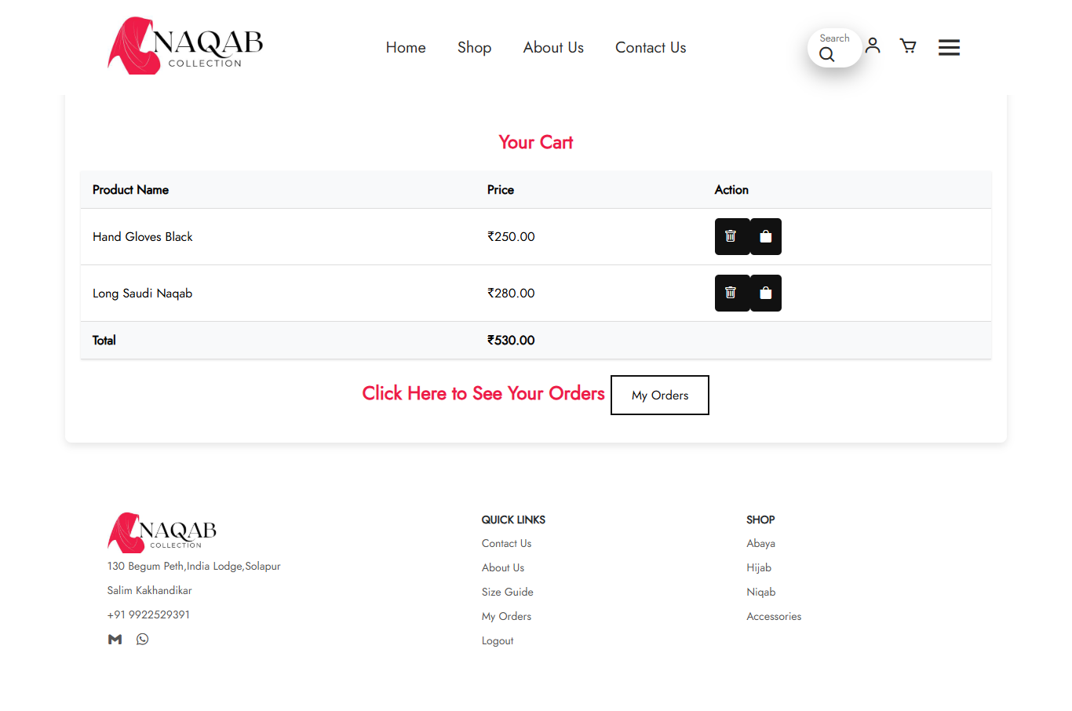
Cart Page
Shows the products added by the user.
Displays product name, quantity, price, and total cost.
Provides options to update quantity or remove items.

Slide 10
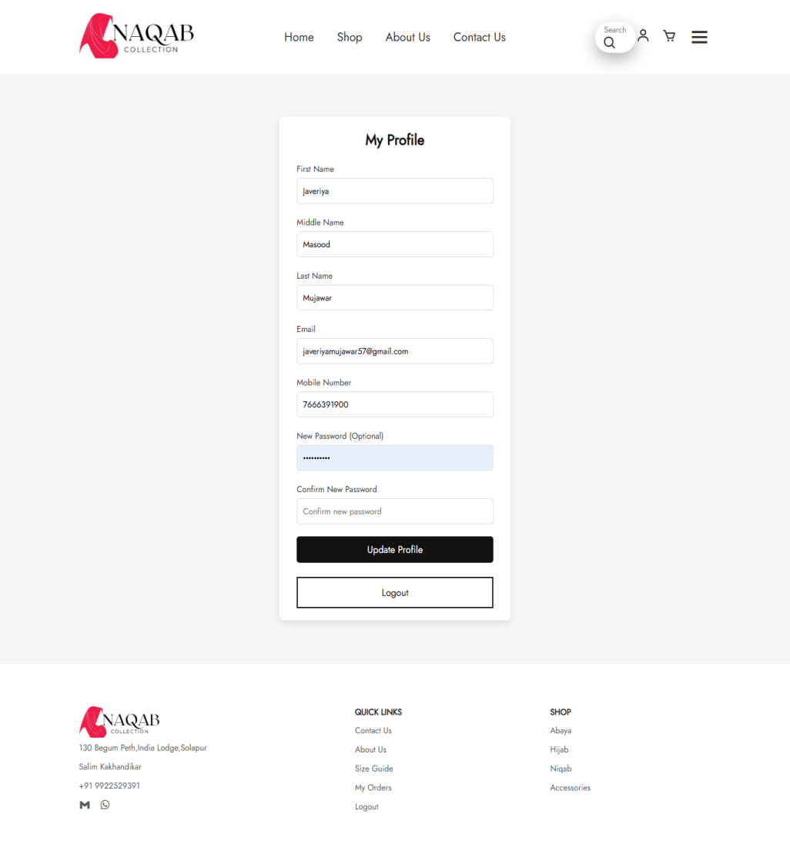
User Profile Page
The page shows user profile that user can update or logout from the website.

Slide 11
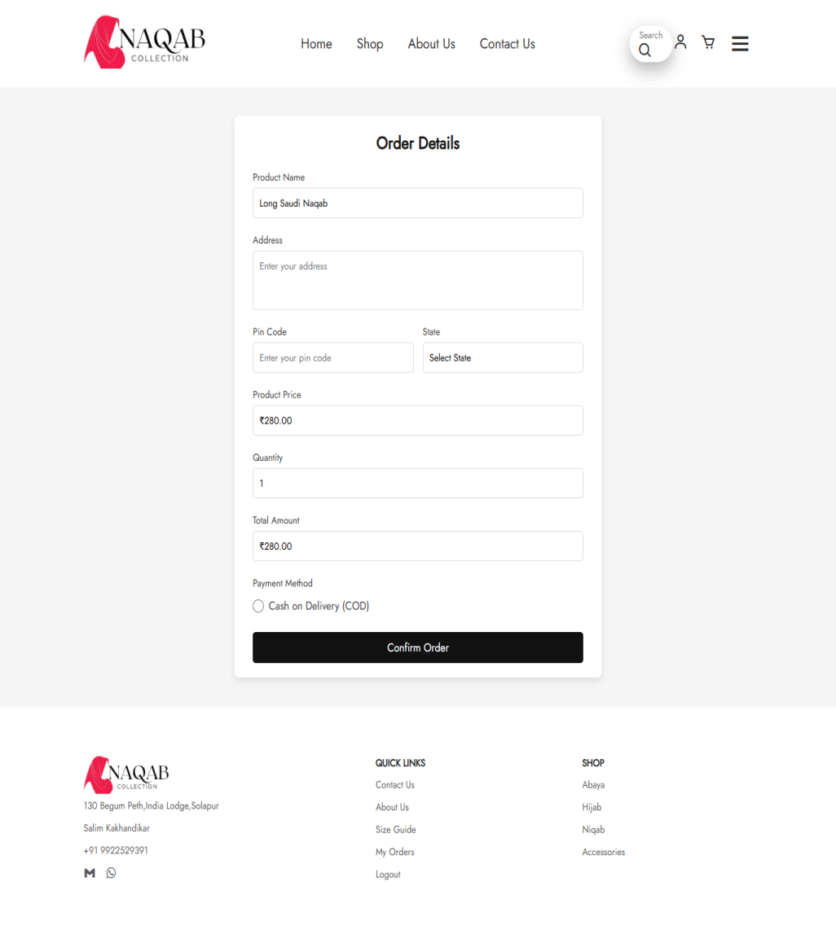
Order Page
Collects shipping details (name, address, phone number).
Allows users to select payment method.
Displays order summary before final confirmation.

Slide 12
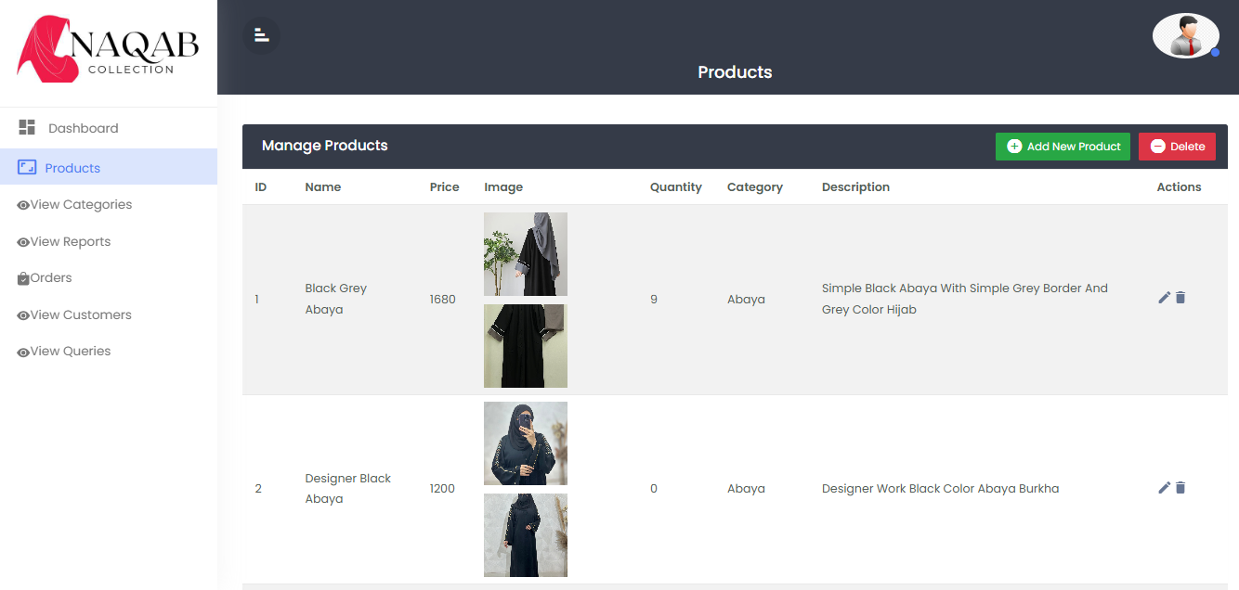
Admin Dashboard
Product Management
Allows admin to add, edit, and delete products.
Manage product images, descriptions, categories, and pricing.

Slide 13
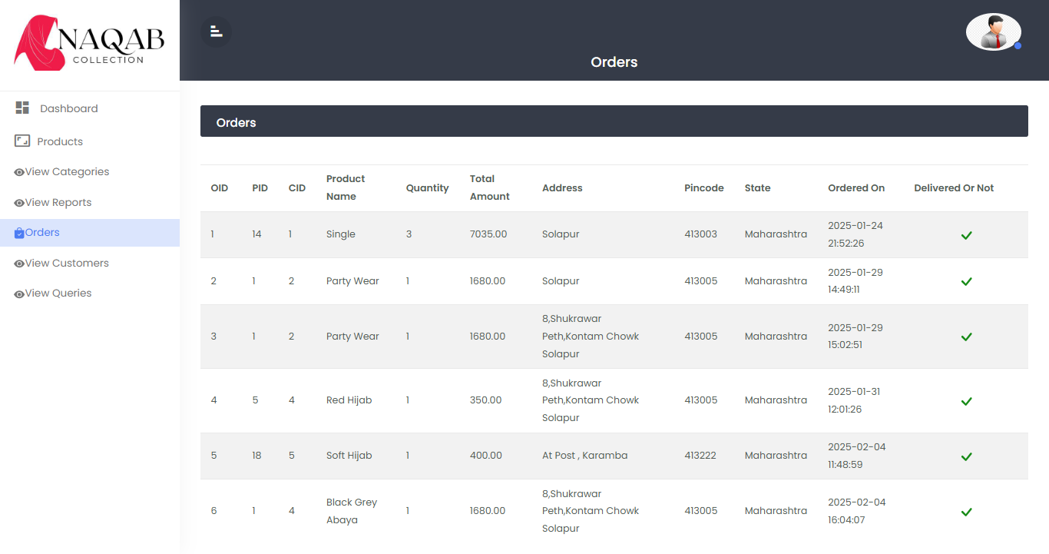
Order Management
View and process customer orders.
Update order statuses (pending or delivered).

Slide 14
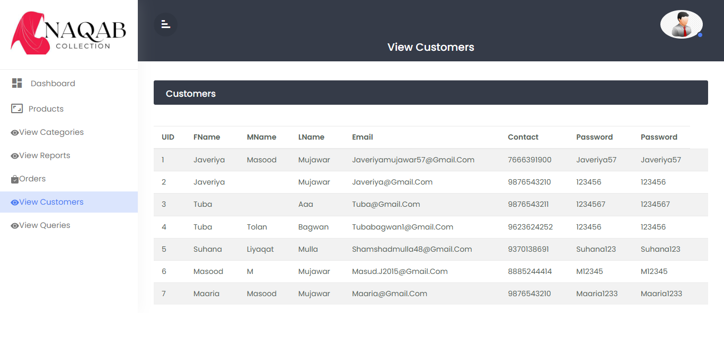
User Management
Manage registered users (view user details).

Slide 15
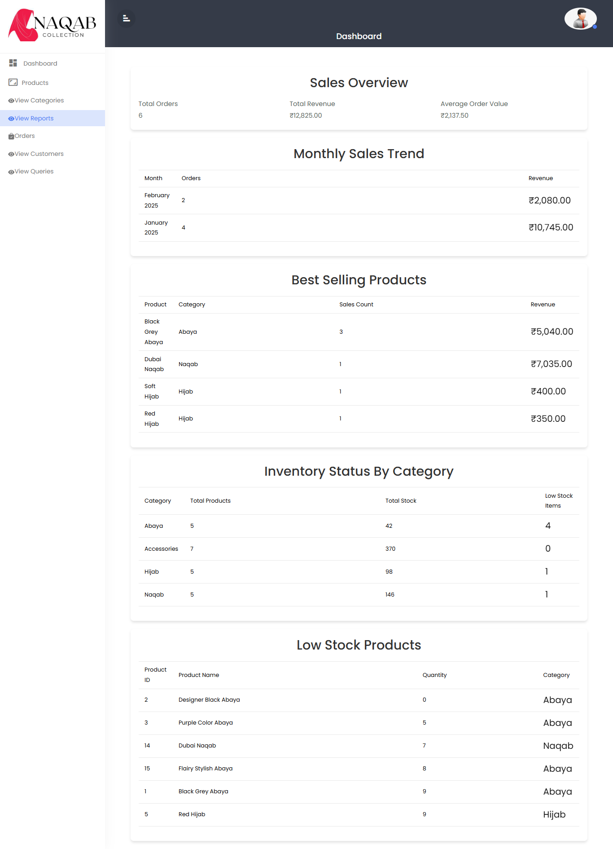
Reports
Displays sales report and inventory analysis.
Filters to view sales by date range, product, or category.

Slide 16
Conclusion
The Burqa Shop Website is a user-friendly e-commerce platform for Islamic women’s clothing, built using PHP, MySQL, HTML, CSS, and JavaScript.
This project enhanced my web development skills, improved our understanding of database management, and provided hands-on experience in e-commerce functionality.
Future enhancements like Integrate online payment gateways (Razorpay, PayPal, UPI, etc.) , Order tracking system, and Email notifications for order confirmation and delivery updates.

Slide 17
THANK YOU!!

